Slide 1
TAKE FIVE Staff Training
GDPR Data Protection
FOCAL POINT
A CLEAR DESK & SCREEN POLICY
Notes:
Title slide = Use the slides you like and TAKE 5 or so minutes to deliver this implementation or reinforcement training.

Slide 2
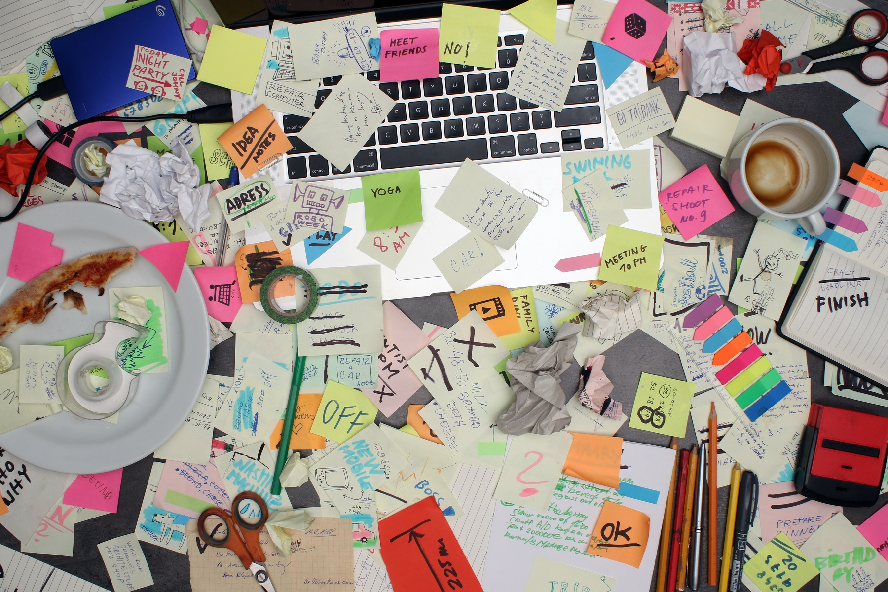
Is a clear desk policy more that just having a clear desk?
Notes:
Facilitator notes:
Acknowledge that clear desk policies can be daunting before they are implemented, especially if paperwork is OUT OF CONTROL.

Slide 3
So, what does a clear desk and screen policy ‘look like’?
BRAINSTORM…
Suggest
1 x benefit or
1 x element you associate with a clear desk and screen policy.
(can be a benefit or an
Notes:
Take one idea from each person (or first 8 – 10), quickly discuss/expand until key points of the policy covered and any MISCONCEPTIONS have been dispelled.
Debrief using next slides.

Slide 4

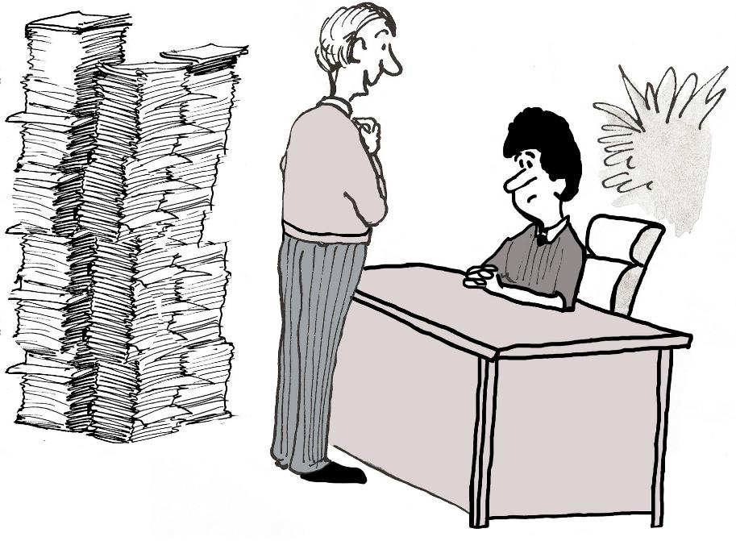

I’m glad to see you’ve cleared everything off your desk
A clear desk policy is all about protecting information…
It’s one of the simplest ways to reduce the risk of a data breach.
Notes:
First some benefits and clarifications…
It’s about protecting sensitive information.
The policy does NOT mean every desk has to be cleared of absolutely everything.
Mouse click – show ‘villain’
Ie: in this cartoon the desk is CLEAR but information is still out of control and vulnerable to being lost or seen by others… increasing the risk of a data breach;
The policy is about keeping control of information and having it stored away or disposed of appropriately, keeping it secure: not leaving it vulnerable to be lost or disclosed to unauthorised people,.

Slide 5

Driving…
Productivity
Creativity
A tidy desk also helps to reduce stress and to work smarter …as well as reducing workplace accidents and spills.
Notes:
Clutter, stress, productivity and creativity
Studies have shown that there is a reduction in stress with employees having a tidy desk and that there is also a reduction in workplace accidents and spills. This in turn reduces time wasting and boosts both productivity and creativity!
However, a clear desk does NOT mean having to remove all personal knick-knacks. These can be important for happiness and well-being that also help people work better.
So, a clear-desk policy that allows some personalisation and helps meet data protection requirements, is a Win Win situation!
Ref:
https://www.ncbi.nlm.nih.gov/pubmed/21228167

Slide 6
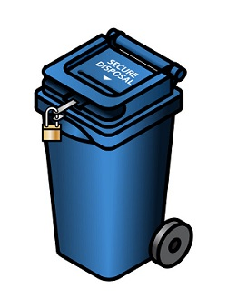
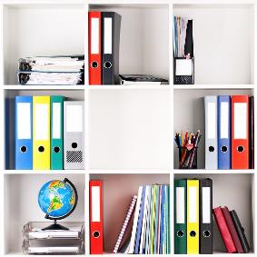

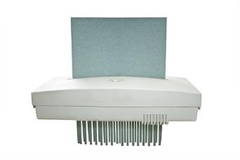
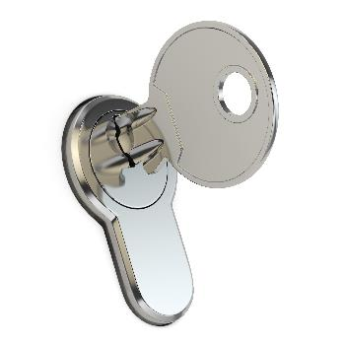
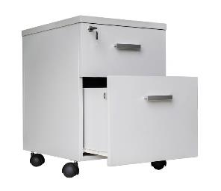
Clear desks… Clear screens…
Angle screens away from view
Lock screens when not in use
Put away all documents and files from desks and worktops at the end of the day
Securely dispose of information that is no longer needed
Keep private information out of sight and confidential information in locked storage at ALL times when not in use
LEAVE IT – LOCK IT!
Notes:
Facilitator Notes:
Mouse clicks 1-4: reveal key features of the policy. (Ask staff to read full policy statements to find out what is expected of them in more detail).
Mouse click 5: remember – LEAVE IT, LOCK IT!

Slide 7

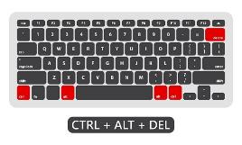
Tools – The 3Ps
Plan
Protect
Pick up
In the morning… Just have out what you need.
When leaving your desk or room … Lock it! Information/door/screen:
At the end of the day… dispose of unneeded documents, file and lock away the rest.
Notes:
How to manage a clear desk approach – the 3Ps
PLAN first thing in the morning.
Keep just the things you need for your workday on your desk. File all other folders and documents in locked storage, but don’t leave the key in!
PROTECT information whenever you leave your desk.
Do not leave confidential or sensitive information unattended on your desk, lock it away, or lock your office door. In addition, if you are not taking your device with you, lock it (e.g. use Alt-Ctrl-Delete – LOCK OPTION for windows PCs, or Control + Shift + Eject for Macs.
PICK UP at the end of the day.
When you leave in the evening, don’t leave documents out or whiteboards with information or data on them. It is essential to file away your documents in locked storage and shred all waste. If you get into the habit of clearing your desk every day before you leave, you’ll enjoy the added productivity benefits that come with a clear desk or office first thing in the morning!

Slide 8
Tools – Information classification
Tip: have a clean up and prioritise lockable storage for confidential & private records.
Tidy/file at end of day
Keep out of sight and store securely
Keep in locked storage whenever it is not in use
PUBLIC
PRIVATE
CONFIDENTIAL
Notes:
Tools that can help - Information Classification
(like government docs use OFFICIAL / OFFICIAL – SENSITIVE / SECRET & TOP SECRET;
DPE suggests for schools to use: Public, Private (incl anything with personal data), Confidential (sensitive personal data + other confidential docs the school produces).

Slide 9
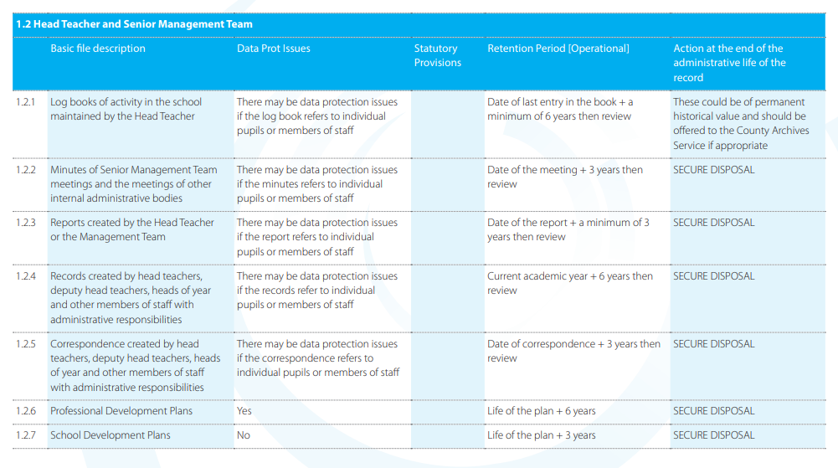
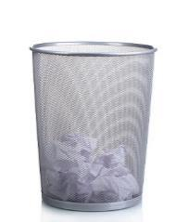

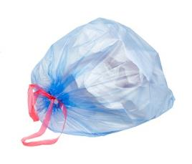
Tools – Retention policy
Tip: Get rid of any duplicate documents or those you no longer need to keep…
General waste - Public info only
SECURE DISPOSAL
Secure disposal – Private and Confidential documents
https://irms.org.uk/page/SchoolsToolkit
Notes:
Tools that can help – Retention policy;
Classification (like government docs use OFFICIAL / OFFICIAL – SENSITIVE / SECRET & TOP SECRET.

Slide 10

COMPETITION TIME!
Which team can best follow the policy over the next XXX WEEKS?
Points awarded for e.g. best clean up, team work
Points awarded for clear desks, work areas and use of available storage
Points deducted for things left out at end of the day e.g.
Papers, Notes, Post-its
Any other documents containing private or sensitive information left on desks or insecurely at any time….
PRIZE - XXXXX
Notes:
Competition time!
You could even create a contest, based on school teams (KS / Admin / SLT etc) , to see which department is best at adhering to the policy and feature an award for the winning team. This is a great idea for when you first get started with your new clean desk policy.

Slide 11
SUMMARY A clear desk policy is more that just having a clear desk…
Take back control of paperwork and information
Keep sensitive information securely locked
Dispose of all information that’s no longer needed
Reduce paper and printouts
..at ALL times
Create a better environment & reduce stress
Notes:
Summary

Slide 12


Any questions
Notes:
Questions

Slide 13

Thank you!
Need independent advice or more information? Need GDPR awareness e-learning for your staff? Or a Policy Check/DPO service?
Email: dpo@dataprotection.education
Tel: 0800 0862018
Author: Jo Kaptijn, Director, Data Protection Education.
Disclaimer: This content is provided for information and training purposes only and should not be relied upon as legal advice or to determine how GDPR might apply to you and your organisation.
Notes:
Thank you

